Slide 1
F
I
R
S
T
C
O
R
N
A
N
I
T
H
I
S
8
.
-
13
1
A free CD of this message will be available following the service
It will also be available for podcast later this week at calvaryokc.com

Slide 2
Some things are always wrong:
1. Murder
185. ____________
2. Stealing
186. ____________
3. Fornication
187. ____________
4. ____________
5. ____________
6. ____________
O
A
N
S
8.1-13
I
I
F
I
R
S
T
C
R
N
T
H

Slide 3
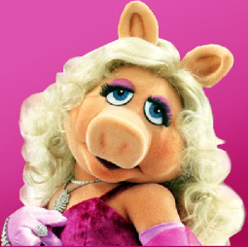
Artichokes ... are just plain annoying ... After all the trouble you go to, you get about as much
actual 'food' out of
eating an artichoke
as you would from
licking thirty or
forty postage stamps. Have the shrimp cocktail instead.
- Miss piggy
O
A
N
S
8.1-13
I
I
F
I
R
S
T
C
R
N
T
H

Slide 4
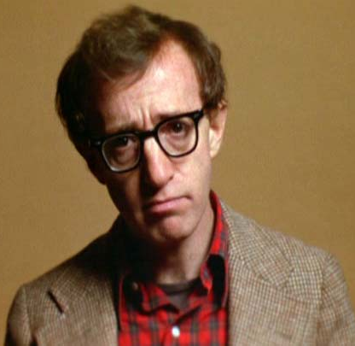
I will not eat oysters. I want my food
dead – not sick,
not wounded –
dead.
- Woody Allen
O
A
N
S
8.1-13
I
I
F
I
R
S
T
C
R
N
T
H

Slide 5
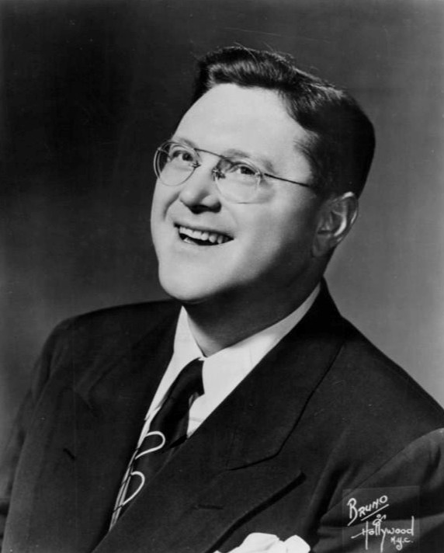
The most remarkable thing about my mother
is that for 30 years she served the family
Nothing but
leftovers. The
original meal has
never been found.
- Sam Levenson
O
A
N
S
8.1-13
I
I
F
I
R
S
T
C
R
N
T
H

Slide 6
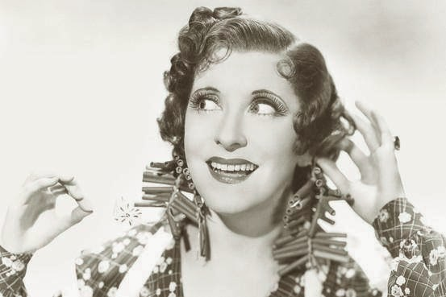
This recipe is certainly silly. It says to separate
two eggs,
but it doesn't
say how far
to separate
them.
- Gracie Allen
O
A
N
S
8.1-13
I
I
F
I
R
S
T
C
R
N
T
H

Slide 7
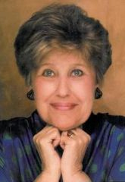
I've been on a constant diet for the last two decades. I've lost a total of
789 pounds. By all
accounts, I should
be hanging from a
charm bracelet.
- Erma Bombeck
O
A
N
S
8.1-13
I
I
F
I
R
S
T
C
R
N
T
H

Slide 8
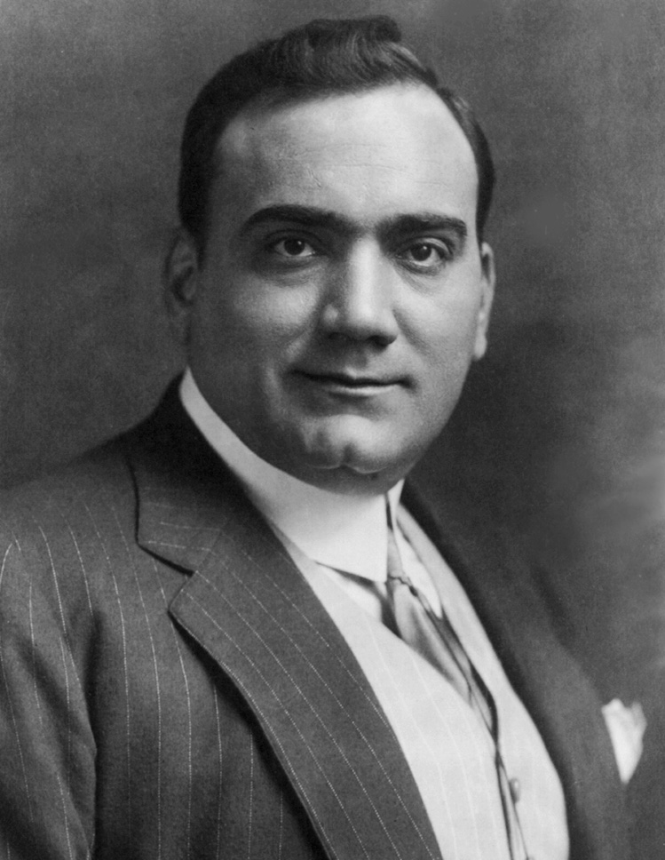
Watermelon …
it's a good fruit.
You eat, you
drink, you wash
your face.
- Enrico Caruso
O
A
N
S
8.1-13
I
I
F
I
R
S
T
C
R
N
T
H

Slide 9
Prov. 26.12 - Do you see a man wise in his own eyes? There is more hope for a fool than for him.
O
A
N
S
8.1-13
I
I
F
I
R
S
T
C
R
N
T
H

Slide 10
Ralph Earle – “(This) is a striking contrast. Intellectualism often inflates a person with pride. We can blow up a balloon in a minute or two, and collapse it in a second with a pinprick. So it is with self-important intellectuals. They can be deflated with a single remark.
O
A
N
S
8.1-13
I
I
F
I
R
S
T
C
R
N
T
H

Slide 11
“But building up with love is something else. Just as one has to lay stone on stone or brick on brick in order to construct a solid building, so we must lay one loving deed on another if we would build a solid life that will last.”
O
A
N
S
8.1-13
I
I
F
I
R
S
T
C
R
N
T
H

Slide 12
Dag Hammarskjöld – “There is a pride of faith, more unforgivable and dangerous than the pride of the intellect. It reveals a split personality in which faith is ‘observed’ and appraised, thus negating that unity born of a dying-unto-self, which is the definition
O
A
N
S
8.1-13
I
I
F
I
R
S
T
C
R
N
T
H

Slide 13
of faith. To ‘value’ faith is to turn it into a metaphysical magic, the advantages of which ought to be reserved for a spiritual elite.”
O
A
N
S
8.1-13
I
I
F
I
R
S
T
C
R
N
T
H

Slide 14
John 13:35 - By this all will know that you are My disciples, if you have love for one another.
O
A
N
S
8.1-13
I
I
F
I
R
S
T
C
R
N
T
H

Slide 15
Matthew Poole – “God hath not given people knowledge that they thereby should be a means to harm and to destroy, but to do good, and to save others; it is a most absurd thing for any to use their knowledge, therefore, to the destruction of others.”
O
A
N
S
8.1-13
I
I
F
I
R
S
T
C
R
N
T
H

Slide 16
Adam Clarke – “Many persons cover a spirit of envy and uncharitableness with the name of godly zeal and tender concern for the salvation of others; they find fault with all; their spirit is a spirit of universal censoriousness; none can
O
A
N
S
8.1-13
I
I
F
I
R
S
T
C
R
N
T
H

Slide 17
please them; and every one suffers by them. These destroy more souls by tithing mint and cummin, than others do by neglecting the weightier matters of the law. Such persons have what is termed, and very properly too, sour godliness.”
O
A
N
S
8.1-13
I
I
F
I
R
S
T
C
R
N
T
H

Slide 18
Isn’t it odd
That a being like God
Who sees the facade
Still loves the clod
He made out of sod?
Now, isn’t that odd?
O
A
N
S
8.1-13
I
I
F
I
R
S
T
C
R
N
T
H

